Slide 1
Data Story 3: Firearm Deaths and Gun Laws
Brandon Chung
10/12/2025

Slide 2
Introduction
Research Question:
  “Do stricter firearm control laws help reduce firearm mortality?”
Data Obtained:
  Mortality Rate by State data obtained via exporting from CDC website.
  Gun Law Strength Rankings by state obtained via manual extraction from Gifford’s gun law strength 2023 annual scorecard.

Slide 3
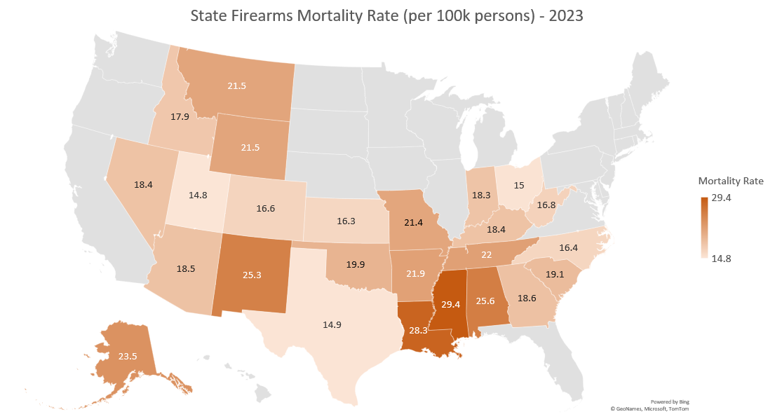
Notes:
Our first visualization highlights the States with the greatest firearm mortality rates. I choose in this visualization to apply color only to States from the top half of the range to help not overwhelm the viewer, and to have color contrast from the States at the top of the spectrum when compared to the bottom.
From our initial visualization of the data, we can tell that certain states are outliers and have extremely high firearm mortality rates. MS, LA, AL, and NM all are at the high end of the mortality spectrum, and it is also pertinent that states on the east and west coasts are at the bottom end of the spectrum along with the States that are more central-north. TX and FL stand out as well as they are surrounded by high firearm mortality rate States but seem to not have as high of a mortality rate. In terms of our research question, the stark contract naturally begs the question that if the difference seen here could be attributed to strict gun laws.

Slide 4
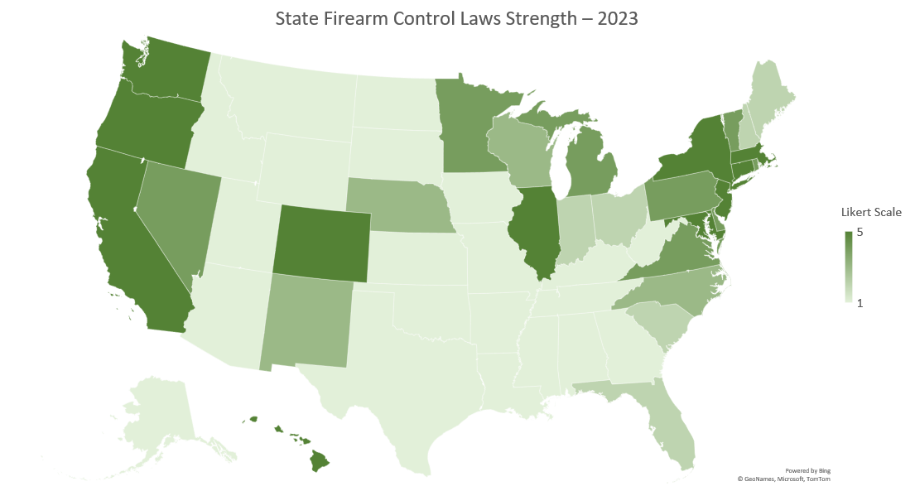
Notes:
When compared to the previous visualization, the visualization here shows that in general States with stricter gun laws can be seen to have lower firearm mortality rates. The west and east coasts, along with the central-north area where we previously saw lower mortality rates show to have stricter gun laws. CO surprisingly has strong gun control laws but had a mortality rate of 16.6.
Our Likert scale was created in line with the Gifford’s gun law strength annual scorecard. A score of A equates to 5, B equates to 4, C equates to 3, D equates to 2, and F equates to 1.

Slide 5
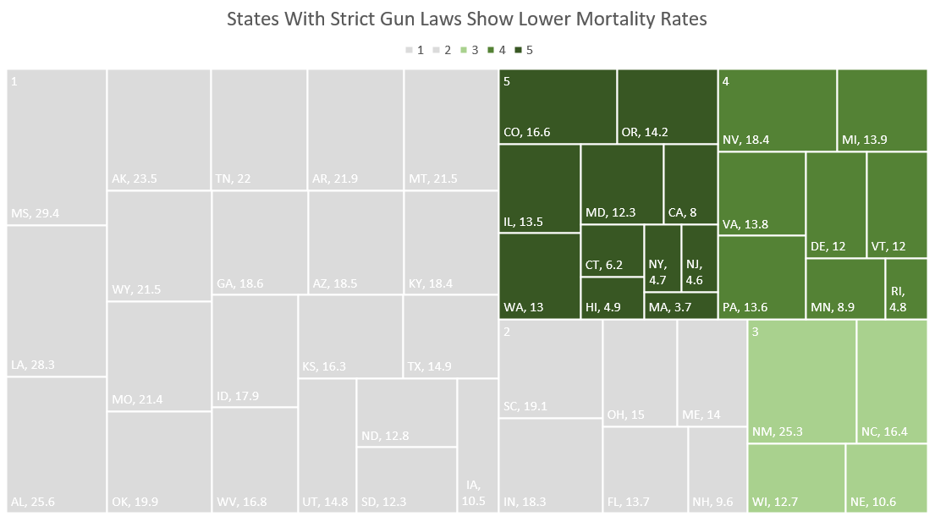
Notes:
What we have found in our study is that stricter firearm control laws can be seen to help reduce firearm mortality. As a concluding visualization, our heat map above highlights that although Likert scale 5, 4, and 3, are the minority of States, they report the lowest mortality rates. A significant change in firearm mortality rate can be seen going from 5 to 4 and to 3. Our States that scored a 5 show multiple single digit rates.

Slide 6
Conclusion
States with a higher Likert score for firearm control law strength boasted lower firearm mortality rates in 2023.
A correlation calculation done on the 1-5 Likert created, and the firearms mortality rate shows a -0.6564 correlation. In real world terms, for each point a state increases on our Likert scale, the state’s mortality rate per 100,000 people decreases by 0.6564.

